Slide 1
DARPA Meeting
2025.9.10

Slide 2
MSU team:
PI: Rongrong Wang, Associate professor, CMSE and Math
Students: Cheng-han Huang, third year CMSE student
Yongliang Sun, first year CMSE student

Slide 3
Goal
ML for CO: Propose novel optimization and machine learning methods for solving classical combinatorial optimization problems.
Non-data-driven
Based on iterative solvers
Focused on designing better problem formulations and developing more effective solvers
Architectural bias of neural network: Analyze the architectural biases in existing neural networks and design new architectures with improved biases.

Slide 4
Goal
ML for CO: Propose novel optimization and machine learning methods for solving classical combinatorial optimization problems.
Non-data-driven
Based on iterative solvers
Focused on designing better problem formulations and developing more effective solvers
Architectural bias of neural network: Analyze the architectural biases in existing neural networks and design new architectures with improved biases.

Slide 5
Motivation
Differentiable Quadratic Optimization For the Maximum Independent Set Problem, Alkhouri et al. ICML 2025.
The paper addresses the Maximum Independent Set (MIS) problem.
It proposes a novel quadratic formulation for MIS by introducing a maximum clique term to enhance convergence.
It leverages GPU parallelism to perform optimization from multiple reinitializations on each graph instance using projected momentum-based gradient descent. This method is referred to as parallelized Clique-Informed Quadratic Optimization for MIS (pCQO-MIS).

Slide 6
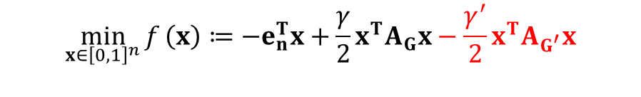
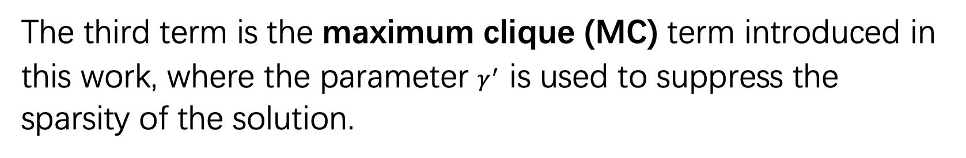
Differentiable Quadratic Optimization for the Maximum Independent Set Problem
The optimization-based reconstruction model proposed in this paper is as follows:
$$\min_{x∈{\left[0,1\right]}^{n}}{f}\left(x\right)≔−e_{n}^{T}x+\frac{γ}{2}x^{T}A_{G}x−\frac{γ^{′}}{2}x^{T}A_{G^{′}}x$$
The third term is the maximum clique (MC) term introduced in this work, where the parameter $γ^{′}$ is used to suppress the sparsity of the solution.
The gradient vector can be expressed as:
$$g\left(x\right)≔∇_{x}f\left(x\right)=−e_{n}+\left(γA_{G}−γ^{′}A_{G^{′}}\right)x$$

Slide 7
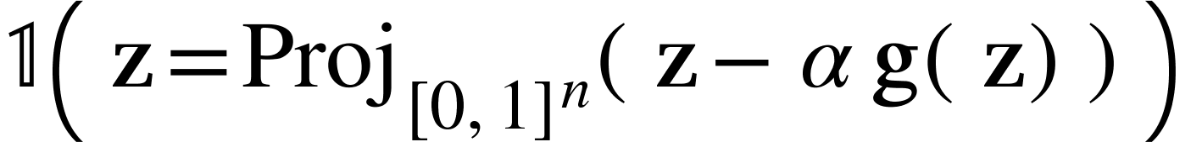


Differentiable Quadratic Optimization For The Maximum Independent Set Problem
Momentum Gradient Descent (MGD) has been shown to be highly computationally efficient in experiments. Its update rule is given by:
$$v←βv+αg\left(x\right)$$
$$x←{Proj}_{{\left[0,1\right]}^{n} }(x−v)$$
To determine whether the result belongs to a MIS:

Slide 8
Current Issues
Memory issue: As the graph size grows, a dense adjacency matrix leads to extremely high memory usage and computational cost..
Convergence speed: Although parallelization reduces runtime, the current algorithm still requires a large number of iterations to converge.
Local minimizers: On sparse graphs, performance lags behind certain fine-tuned classical methods.
Heavy tuning: The algorithm demands extensive parameter tuning to achieve optimal performance.
Scope of applicability: The approach has not yet been extended to other CO problems.

Slide 9
Things we are trying
1. New stochastic approach to address the memory issue
Idea: Instead of processing the full graph at each iteration, we draw a random subgraph, and the corresponding adjacency matrix is, which effectively reduces the memory and computation burden.
Possible issues: the algorithm may become unstable, or even diverge
Things to explore:
how to draw the subgraph?
How sparse the subgraph can be?
How to reduce the variance introduced by the randomness?
What iterative solver it is compatible with?
Which CO problems can particularly benefit from it?
.

Slide 10
Things we are trying
2. Ways to accelerate the convergence
Idea: 1. use second order solvers Newton/LBFGS instead of MGD
2. use historical information to facilitate convergence, e.g., use the frequency each node appear in previous solution to initialize the variable in future instances
Possible issues: second order methods may be unstable, and more likely to stuck at local minimizers
Things to explore:
How much acceleration do second-order methods provide?
Is there a trade-off between speed and accuracy?
Is it possible to achieve both?
Which CO problems can benefit from them?
.

Slide 11
Subgraph sampling

Slide 12
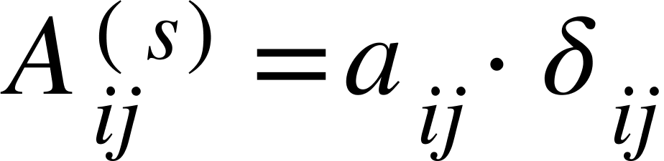
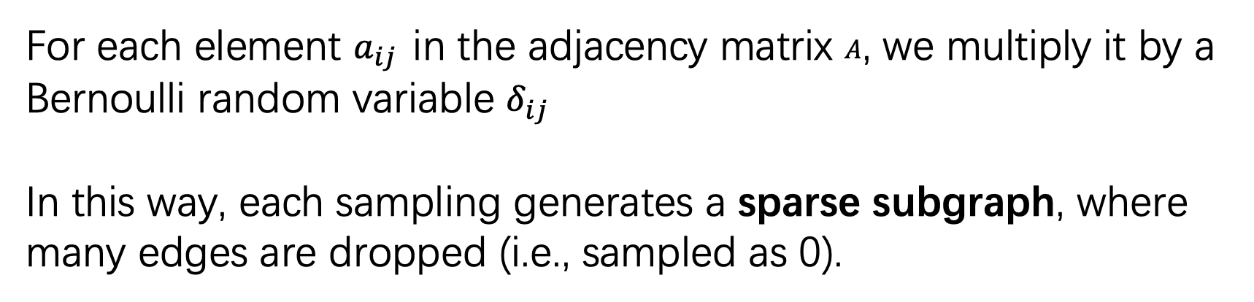
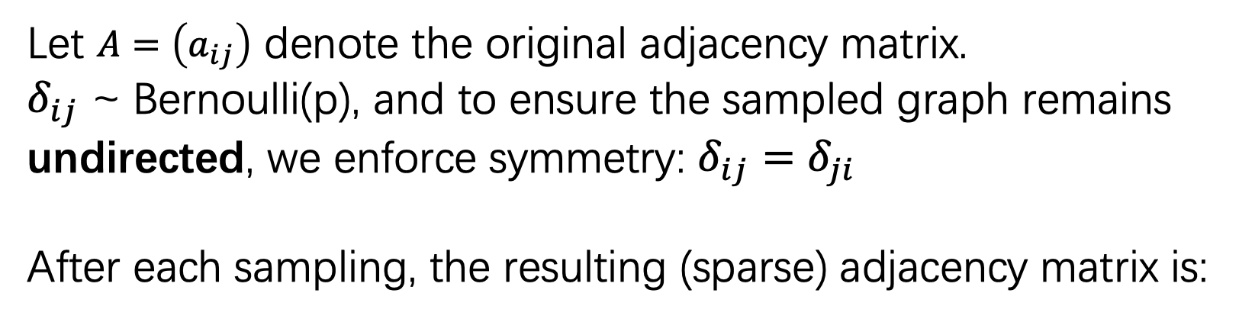
Step 1: Bernoulli Sampling
For each element $a_{ij}$ in the adjacency matrix $A$, we multiply it by a Bernoulli random variable $δ_{ij}$
In this way, each sampling generates a sparse subgraph, where many edges are dropped (i.e., sampled as 0).
Let $A=\left(a_{ij}\right)$ denote the original adjacency matrix.
$δ_{ij}$ ~ Bernoulli(p), and to ensure the sampled graph remains undirected, we enforce symmetry: $δ_{ij}=δ_{ji}$
After each sampling, the resulting (sparse) adjacency matrix is:

Slide 13
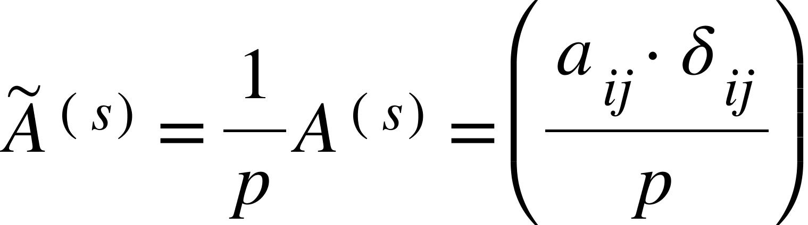
Step 2: Normalization:
To ensure that the sampled matrix is an unbiased estimator of the original matrix in expectation, normalization is required:

Slide 14
Result
In this experiment, we conduct tests on
ER([200, 400, 600, 800], 0.5, seed 0).
 | p_sample = 0.1 | p_sample = 0.3 | p_sample = 0.5 | p_sample = 0.7
N=200 | 9.5 | 8.9 | 9 | 8.7
N=400 | - | 8.8 | 8.9 | 9.3
N=600 | - | 9.55 | 9.55 | 9.5
N=800 | - | 11 | 9.85 | 9.8
Observed issue: When the sampling probability p-sample is too small, the algorithm may fail to find a feasible solution in some runs.

Slide 15
For Next Meeting
We aim to optimize the current implementation and enrich the experimental results.
We further explore whether there exists a strategy that ensures solution quality even when the sampling probability p is very small.

Slide 16
Second order methods and reinitialization

Slide 17
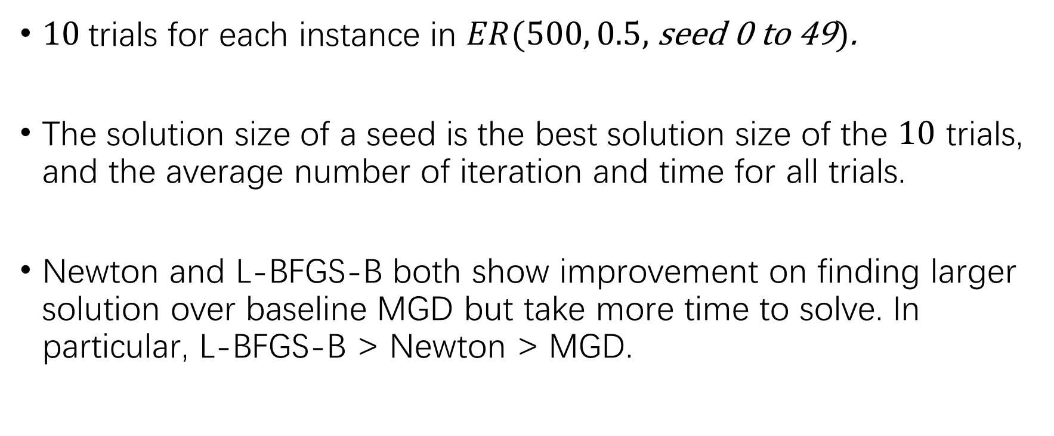
Newton and L-BFGS-B
$10$trials for each instance in $ER(500, 0.5,$ seed 0 to 49$)$.
The solution size of a seed is the best solution size of the $10$ trials, and the average number of iteration and time for all trials.
Newton and L-BFGS-B both show improvement on finding larger solution over baseline MGD but take more time to solve. In particular, L-BFGS-B > Newton > MGD.

Slide 18
Newton and L-BFGS-B
Comparison by solution size:
Comparison by iteration number/time:
L-BFGS-B > Newton | Tie | L-BFGS-B < Newton
13 | 32 | 5
 | L-BFGS-B | Newton
Average solution size | 11.26 | 10.96
 | L-BFGS-B | Newton
Average iteration number | 167.1 | 76.3
Average time | 0.7411 | 0.1350

Slide 19
Baseline MGD with and without Third Term
Comparison by solution size:
Comparison by iteration number/time:
 | MGD without Third Term | MGD with Third Term
Average solution size | 10.8 | 10.8
 | MGD without Third Term | MGD with Third Term
Average iteration number | 85.6 | 86.3
Average time | 0.0196 | 0.0260

Slide 20
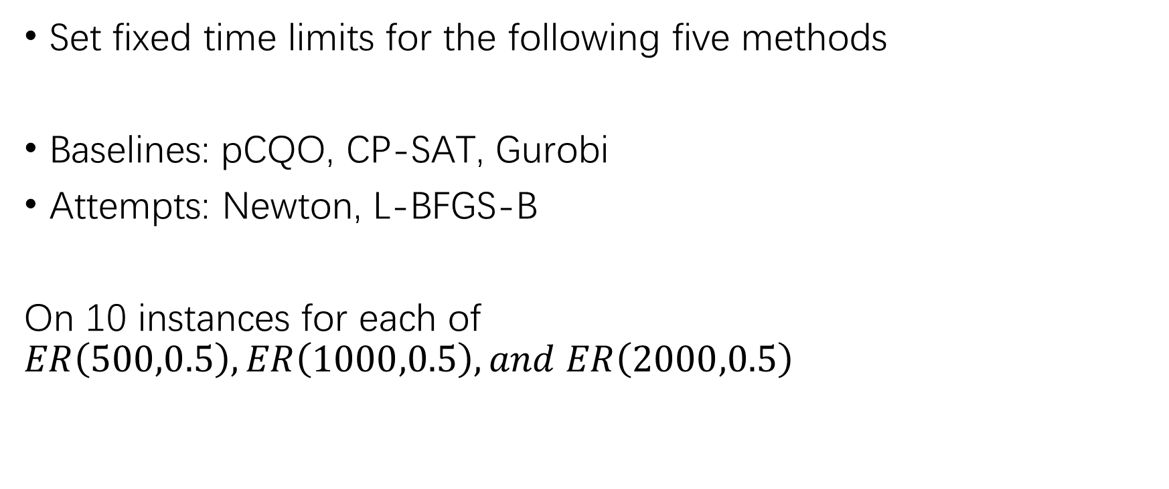
Updated Baseline Method Comparison
Set fixed time limits for the following five methods
Baselines: pCQO, CP-SAT, Gurobi
Attempts: Newton, L-BFGS-B
On 10 instances for each of $ER\left(500,0.5\right),ER\left(1000,0.5\right),and ER\left(2000,0.5\right)$

Slide 21
Updated Baseline Method Comparison
Graph, Time | MGD | CP-SAT | Gurobi | Newton | L-BFGS
ER(500,0.5), 5 sec | 12 | 12 | 8.7 | 11.2 (11.2) | 11.1 (11.1)
ER(1000,0.5), 5 sec | 11.5 | 0 | 9.5 | 11.8 (9.3) | 11.2 (11.2)
ER(1000,0.5), 10 sec | 11.8 | 11.4 | 9.5 | 12.2 (9.5) | 11.6 (11.4)
ER(2000,0.5), 10 sec | 10.8 | 0 | 10.4 | 10.5 (9.7) | 11.8 (11.8)
ER(2000,0.5), 20 sec | 12.1 | 0 | 10.4 | 10.8 (9.7) | 11.8 (11.8)
For Newton and L-BFGS, we report results for both the objective with and without the third term (the clique informed penalty).
Note that both integer programming methods uses thread-based parallelization, but the three gradient-based methods do not.
Maximum iteration for the three gradient based methods are set to 150 across all runs, leading to possible failing cases which report 0 that drags down the average solution size in for larger graphs.

Slide 22
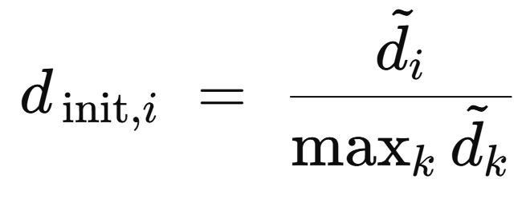
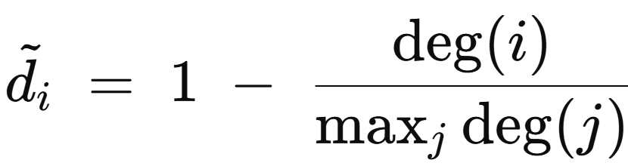
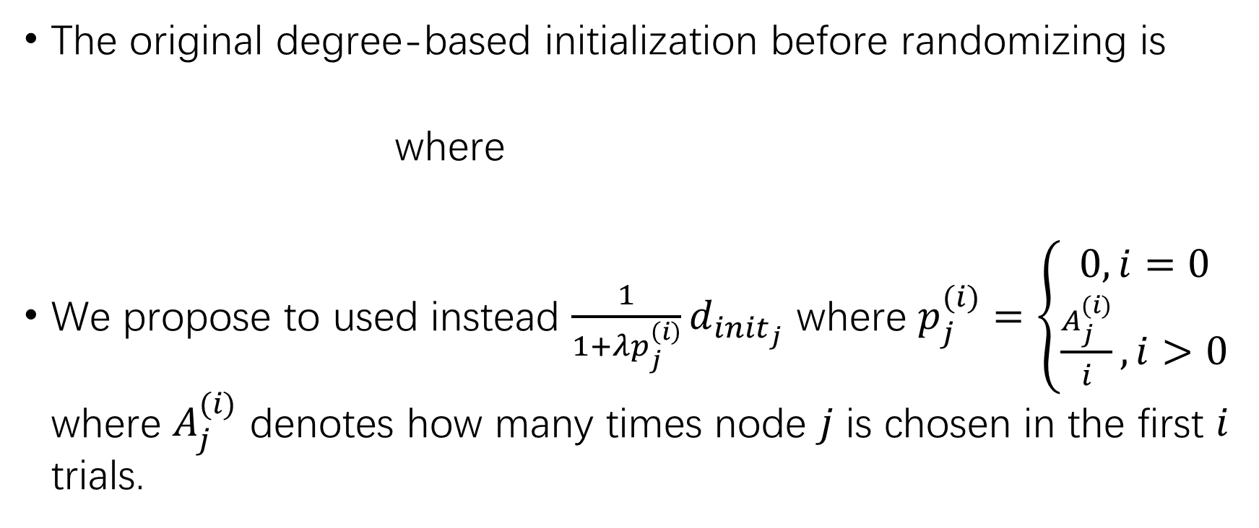
Reinitialization
The original degree-based initialization before randomizing is
where
We propose to used instead $\frac{1}{1+λp_{j}^{\left(i\right)}}d_{init_{j}}$ where $p_{j}^{(i)}=\left\{\begin{aligned}0, i=0 \\ \frac{A_{j}^{(i)}}{i}, i>0\end{aligned}\right.$ where $A_{j}^{(i)}$ denotes how many times node $j$ is chosen in the first $i$ trials.

Slide 23
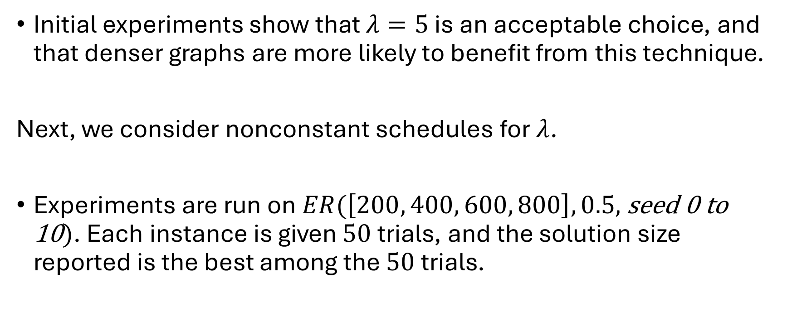
Reinitialization
Initial experiments show that $λ=5$ is an acceptable choice, and that denser graphs are more likely to benefit from this technique.
Next, we consider nonconstant schedules for $λ$.
Experiments are run on$ER(\left[200, 400, 600, 800\right], 0.5,$ seed 0 to 10$)$. Each instance is given $50$trials, and the solution size reported is the best among the $50$trials.

Slide 24
For Next Meeting…
More experiments on nonlinear lambda schedules, and possible explanations to why or why not some methods work/don’t work.
Explore more hyperparameters setting for Newton method; is Newton method bad, or is it because we didn’t have the best setup for it?
Possible L-BFGS tuning.

Slide 25
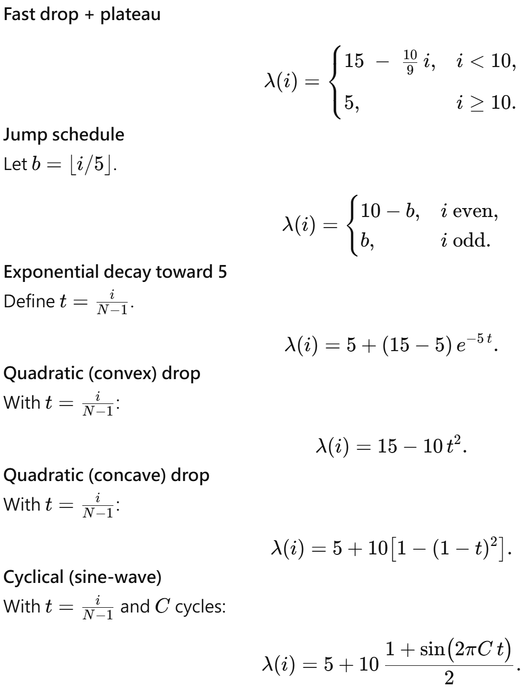
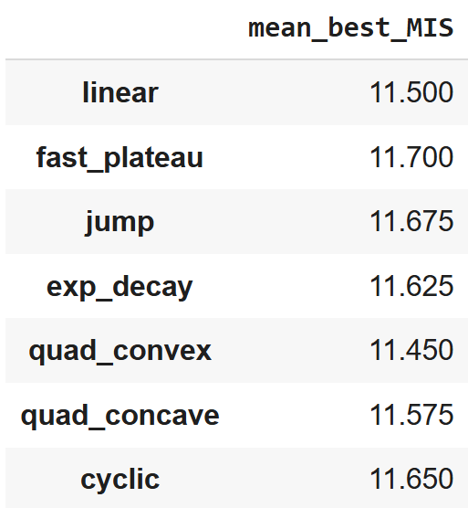

Reinitialization
Different choices of lambda schedules. $C=3$.

Slide 26
For next week
Torch’s L-BFGS
Graph construction with specific MIS and other controls

